Slide 1
Term 2 Assignment Group Number: 7 Group Name: The Legendaries Fake News detection
No. | Surname, Initial | Student Number
2 | Mkalali S | 2 | 2 | 0 | 0 | 4 | 2 | 9 | 2 | 6
3 | Msomi S | 2 | 1 | 6 | 0 | 2 | 8 | 6 | 0 | 4

Slide 2
Domain area of the Problem
Our domain area of the problem is the spread of Covid-19 fake news, mostly on social media. Social media has allowed people the ability to exchange information at a much greater pace, to a far wider audience than ever before. However, this information is not always truthful.
Since we have found out that more consumption of news was though the corona virus pandemic, the spread of COVID-19 fake news aroused on social media.
In our communities this excessive rise of fake news has had a bad impact where by people were scammed through applications of RDC grant. Their personal information like identity numbers, contacts, addresses were gathered.

Slide 3
Domain area continues…
Cybercriminals have quickly adapted to use the Covid-19 pandemic as an opportunity to launch attacks in vulnerable environments. For instance people were given links for Covid-19 “youth brigade” recruitment, learner-ships to send their documents to all in the name of scamming.
There was also helpline claiming that it provide food parcel, where people would be asked to provide their details (name ID number and their income)in order to provide them food parcel while they were going to use their details to do fraud.

Slide 4
Domain area continues…
A WhatsApp video that was misleading people to deny to test because it claimed that testing kits are contaminated with the virus, and vaccines are being tested on Africans only to kill them, voice note circulating claiming that one recovered after drinking the Old Brown Sherryl alcohol which was not true.
After all these harmful issues we have decided to raise awareness about fake news so people can be able to determine and differentiate when something is real or fake.
We have decided to design the web application that will help to eliminate the spread of fake news in social media that is misleading people to be victims of such incidents.

Slide 5
Aim and objectives
The main aim of this project is to raise awareness about the impact of fake news across the country.
We will raise this awareness by creating a web application reason being that we are a digital generation therefore news travel faster through social media networks. The motivation behind this is the new laws about the impact of fake news.
By creating this app we will not only be raising awareness but we will also be sharing knowledge and eliminating the knowledge gap within the digital space where news are concerned.

Slide 6
Aim and objectives continues…
The main objective of our research is to implement a solution that will fact-check information on social media before allowing publication, where misinformation will be collected and tracked and denied publications where necessary.
We plan on taking a closer look to checking the source of the story, and if it is unfamiliar or no factual source relates to the claims, there will be no publication allowed unless otherwise the person appears to the authorities on their new claims with sufficient references.
This will help everyone who has once been affected by fake news to know best next time, and also the future generation to be able to identify what’s real, and fake on the media.

Slide 7
Pre-conditions
Before developing our application, we need to know if this application is feasible or not, which in this case it is.
We should also have researched briefly about fake news in general and specifically about Covid-19 news so that we may have a clear understanding of what is factual, so that it will be much easier to detect what is untrue.
We will need the equipment and enough resources to develop. This includes machines and resources suitable software for development, good programming language, good testing skills.

Slide 8
Pre-conditions continues…
The following are the pre-conditions of the application itself:
We will require a user to be registered to the application before they can be able to access the services provided.
There will be a data validation check for the login details so that a user logs into the website even when the credentials don’t match.
Because we will be working with people’s information, we will make sure that our security is very secure and no data will be breached in anyway.
The data that we will use to prove whether the data searched by users is true or false should be scientifically proven because Covid-19 is a medical issue.

Slide 9
Pre-conditions continues…
Under a user’s profile, there will be a history set up to keep anything that goes on the search box in that particular profile to keep it in case a use needs to search it again.
We will use all words of a heading or line on a search box to identify whether the article or news are real or not, not just a portion of it. This will be much more easier for links to certain new and/ articles.

Slide 10
Dataset required for testing
Online news can be collected from different sources, such as news agency homepages, search engines, and social media websites.
We will have two parts to the data gaining process, ‘’fake news’’ and ‘’real news’’. Having this fake news was easy as Kaggle released a fake news dataset consisting 10 articles that about corona virus. It will be easy to get the real news for the fake news dataset. The real news can be found on reliable sources. The real news was generated from https://sacoronavirus.co.za/
We will use Fact-checking and Text-classification algorithms for our output.

Slide 11
Dataset required for testing continues…
We will have our algorithm choice, given the dataset, after selecting the features, we should choose the suitable algorithm to extract these features from the dataset.
Specified the dataset, algorithm, and parameters, training uses computational resources in order to build a model of the data in order to predict the outputs on new data.
When we want to solve a problem using machine learning. A dataset with several explanations is provided for the classifier to help it finding the category of a new given observation.

Slide 12
Normal flow of events
Algorithm 1: Analyze Web link
Input: Web link to a news article.
Output: (1) Domain name.
Title: Real/fake.
Content: fake/real.
Step 1. Verify if the introduced link is trusted or not
Step 2. If the introduced link is classified as trusted output:

Slide 13
Normal flow of events continues…
(1) Domain name.
3) The title of the article.
(4) The content of the article.
Else, print not trusted
Error conditions: If web link is invalid a banner message will be populated stating that the link is invalid or does not exist. We will use error handling

Slide 14
Normal flow of events continues…
Algorithm 2: Analyse Title of the article
Input: Title of the article
Output: fake/real
Step 1. Get the title of the article from the datasets
Step 2. Print the title
Possible error conditions: If Title is invalid a banner message will be populated stating that the link is invalid or does not exist. We will use error handling.

Slide 15
Normal flow of events continues…
Algorithm 3: Analyse the content
Input content of the article.
Output: Real/fake
Step 1. Read the dataset with fake and real news and divided it into train and test sets.
Step 2. Build the text representation model
Step 3. Fit the train data to machine learning classifiers
Step 4. Predict the label (fake/real) of the article content using the machine learning classifiers
Step 5. Use the test data to calculate the accuracy score for the machine learning classifiers

Slide 16
Normal flow of events continues…
Possible error conditions: If content is invalid a banner message will be populated stating that the link is invalid or does not exist. We will use error handling.
Machine learning (ML): to solve the problem of constructing computer programs that improve by experience. We used machine learning models to verify the article content and title. Using machine learning, we will be able to: check if the title is fake or real; decide if the article content is fake or real.

Slide 17
Post-conditions
The system will prohibit the users from registering for more than once. They can only continue to login, not multiple registrations for one user.
After a user has entered their search data, the results will show underneath the search title whether it is false, or factual.
After outputting the results, the system still allows the user to make more searches and it will still bring the results because there is no limit for the searches a user can make per entry.

Slide 18
Post-conditions continues…
Users will have a sense of the real news and the fake news to their attention than they did before.
We will make sure no data is breached. If you build an app or software that collects user data, such as names, email addresses, dates of birth, or telephone numbers, then it is our responsibility to keep that data secure. That means complying with data protection laws.

Slide 19
Features to be tested
Domain name of the website: We will test the domain name if it’s credible or not. The test will fail if the domain link is invalid.
For title: If the title is real or fake. We will test the title of the article. The test will fail if the title can’t be found.
For content: If the content is real or fake. The test will fail if the content searched is invalid, or not found.
We will test if the application is compatible with every device. We will perform a unit test because we will be testing individual functions or methods with objects to access the functionalities.

Slide 20
Features to be tested continues…
We will also test the non-functional requirements a follows:
Performance: how long does the application take to retrieve the results from the application back to the user.
Reliability: how can the system be trusted to bring accurate results.
Quality: the system will not randomly crash and very user-friendly.
Security: how secure the system is to keep people’s data only to themselves.
Maintainability: can the system be maintained and adapt to changing environments.

Slide 21
Entrance and Exit criteria
We take a dataset as input; the output of the algorithm will depend on the input dataset. If the input is fake/real news dataset, then the output displays if the article is fake/real.
The entrance criteria will be the dataset, if the dataset is inputted the test pass else fail.
The exit criteria will include validated tests cases, test data and pass/fail criteria. The exit criteria will populate a banner message conforming that if a user want to exit the application.

Slide 22
Acronyms
ML: Machine Learning
DB: Database
AI: Artificial Intelligence
API: Application Programming Interface

Slide 23
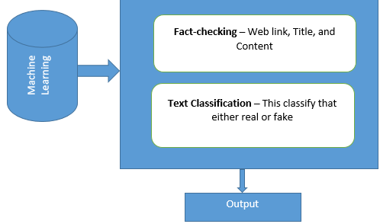
Graphics to explain the problem
Dataset

Slide 24
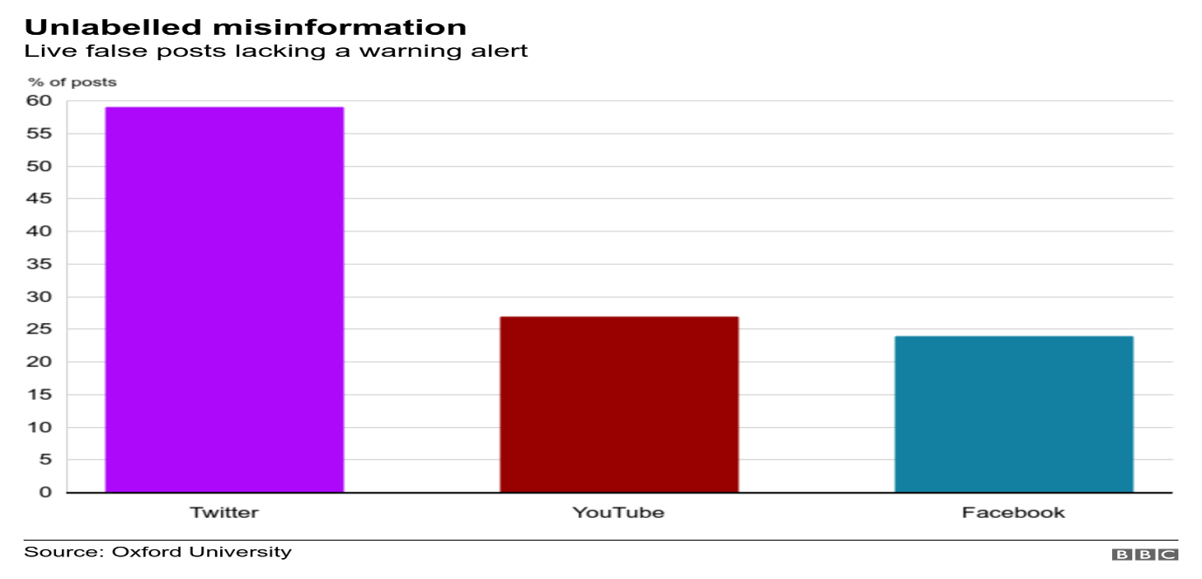
Graphics continues…
The graph above shows that how fake news about Corona virus spread through social networks.

Slide 25
Conclusion
Our project is only limited in focusing on detecting the integrity of the news found in articles, journals, blogs or any other platform providing news, meaning it will only accept links with information.
For example, if you paste a Facebook link, an error should pop up that tells you the application does not support the source of information you are trying to retrieve.

Slide 26
The end

